Slide 1
SMART HOME AUTOMATION AND SECURITY SYSTEM
CEIS101: Final Course Project
January 2024
Amberlyn Sisk
Professor Oscar Trevizo

Slide 2
INTRODUCTION
In this course, we learned about the Internet of Things (IoT) and how it is growing exponentially. For the course project, we integrated hardware, software, and networks by building a smart home automation and security system. We first started this process by building a prototype in TinkerCad, we then built the hardware for the system using components from the IoT Tech Core Kit and we finally programmed the system using the Arduino IDE. The following presentation will show and describe each part of the process.

Slide 3
MODULE 2 PROJECT: BUILDING A PROTOTYPE IN TIKERCAD
The following slides show how we utilized TinkerCad to build a prototype of the smart home automation and security system.

Slide 4
CIRCUIT (SCREENSHOT)

Slide 5
CODE (SCREENSHOT)

Slide 6
MODULE 3 PROJECT: IoT KIT & BUILDING A CIRCUIT
The following slides show the inventory of our IoT Tech Core Kit as well as a circuit with a red LED. The final slide in this set shows the serial monitor in Arduino IDE that shows the red LED turning on and off.

Slide 7
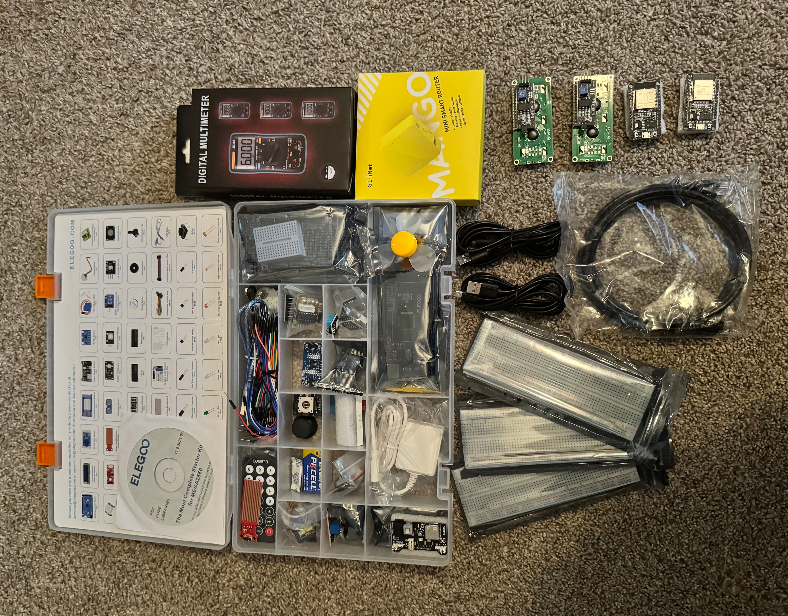
INVENTORY OF IoT KIT (PICTURE)
UCTRONICS Kit
ESP32 (2)
LCD Modules (2)
Breadboards (3)
Mini Router
Patch Cable
Digital Multi Meter
USB to Micro USB (2)

Slide 8
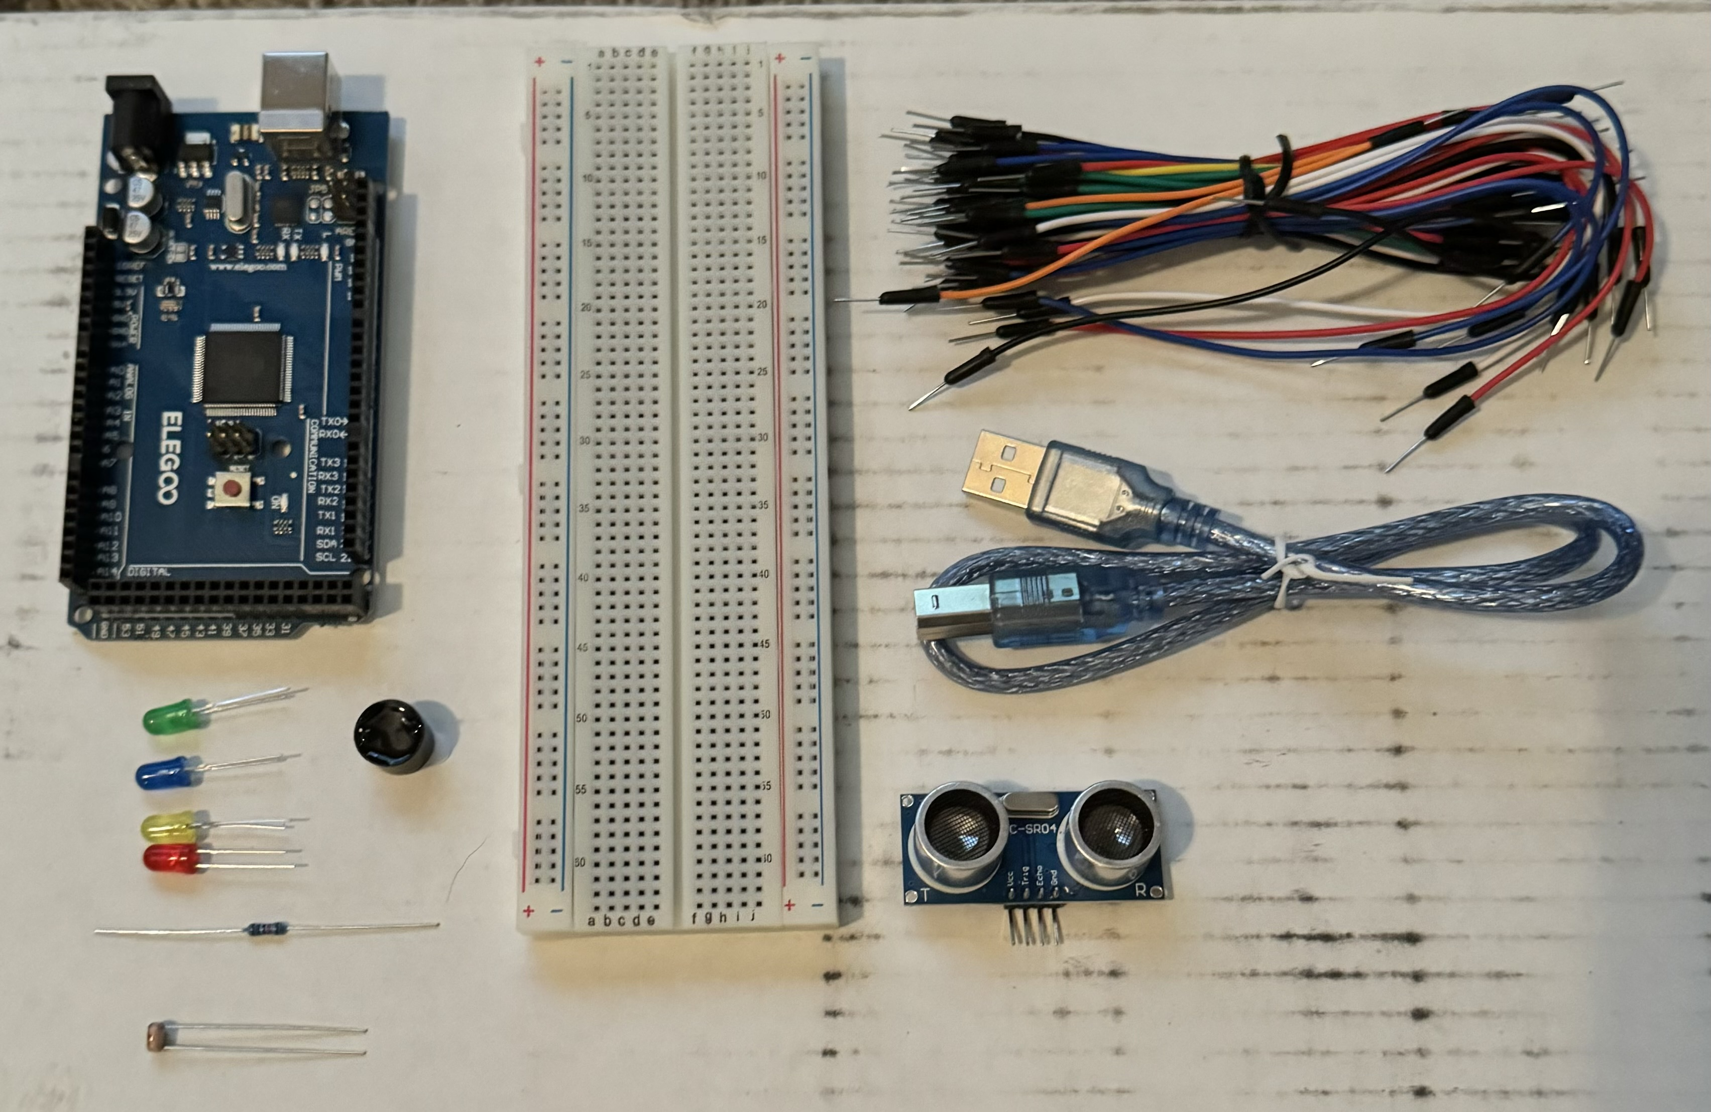
ORGANIZATION OF PROJECT COMPONENTS (PICTURE)
Arduino Mega 2560
Breadboard
Resistor 10kΩ
LEDs
Ultrasonic Sensor
Active Buzzer
Photoresistor
Wires
USB Type B cable

Slide 9
CIRCUIT WITH RED LED ON (PICTURE)

Slide 10
SERIAL MONITOR (SCREENSHOT)

Slide 11
MODULE 4 PROJECT: ADDING A DOOR SENSOR
In this portion of the project, we added a door sensor with an alarm and a green LED. This simulated a door being open or shut, when the door was shut, the alarm would be silent and the green LED would be lit, and when the door was open the alarm would sound with the red LED lit.

Slide 12
CIRCUIT OF DOOR CLOSED WITH GREEN LED ON (PICTURE)

Slide 13
CIRCUIT OF DOOR OPEN WITH GREEN LED OFF (PICTURE)

Slide 14
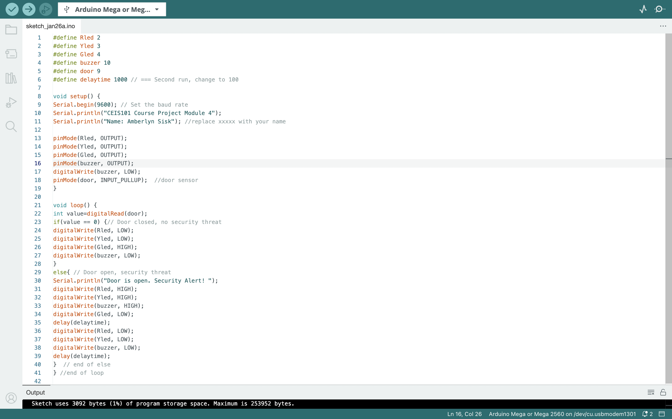
ARDUINO CODE (SCREENSHOT)

Slide 15
SERIAL MONITOR (SCREENSHOT)

Slide 16
MODULE 5 PROJECT: ADDING DISTANCE SENSOR
In this portion of the project, we added a distance sensor and a yellow LED to the circuit. If an object was more than 12 inches away from the sensor, the green LED would be lit. If an object was between 6 and 12 inches from the sensor, the yellow LED would be lit. Finally, if an object was 6 inches or less from the sensor, the alarm would sound and the red LED would be lit.

Slide 17
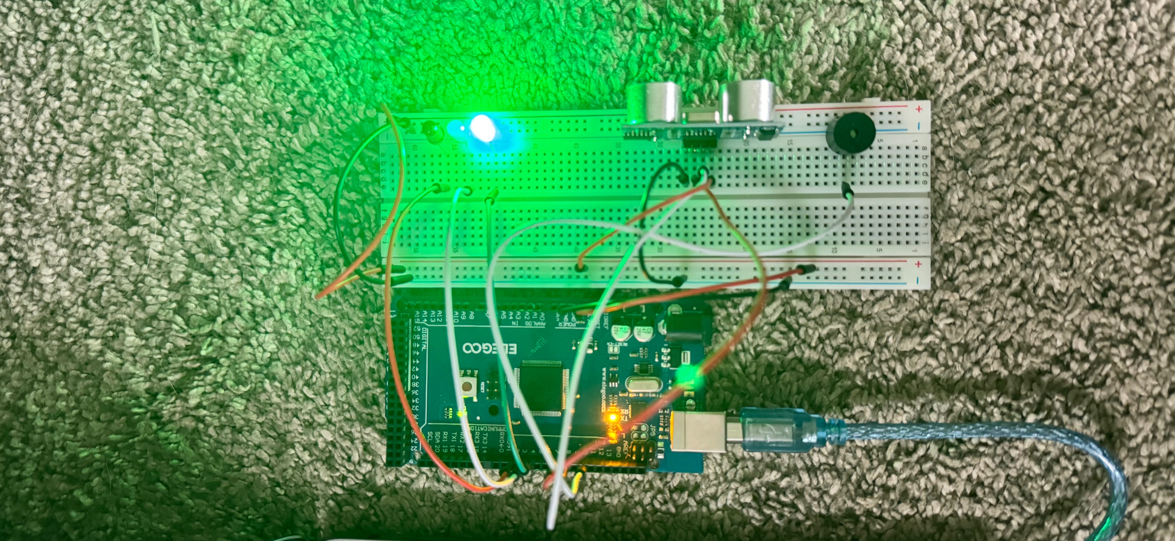
CIRCUIT WITH GREEN LED ON (PICTURE)

Slide 18
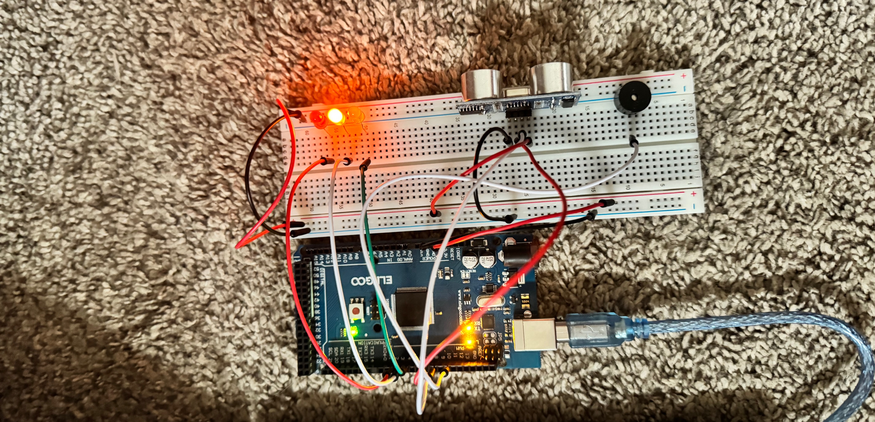
CIRCUIT WITH YELLOW LED ON (PICTURE)

Slide 19
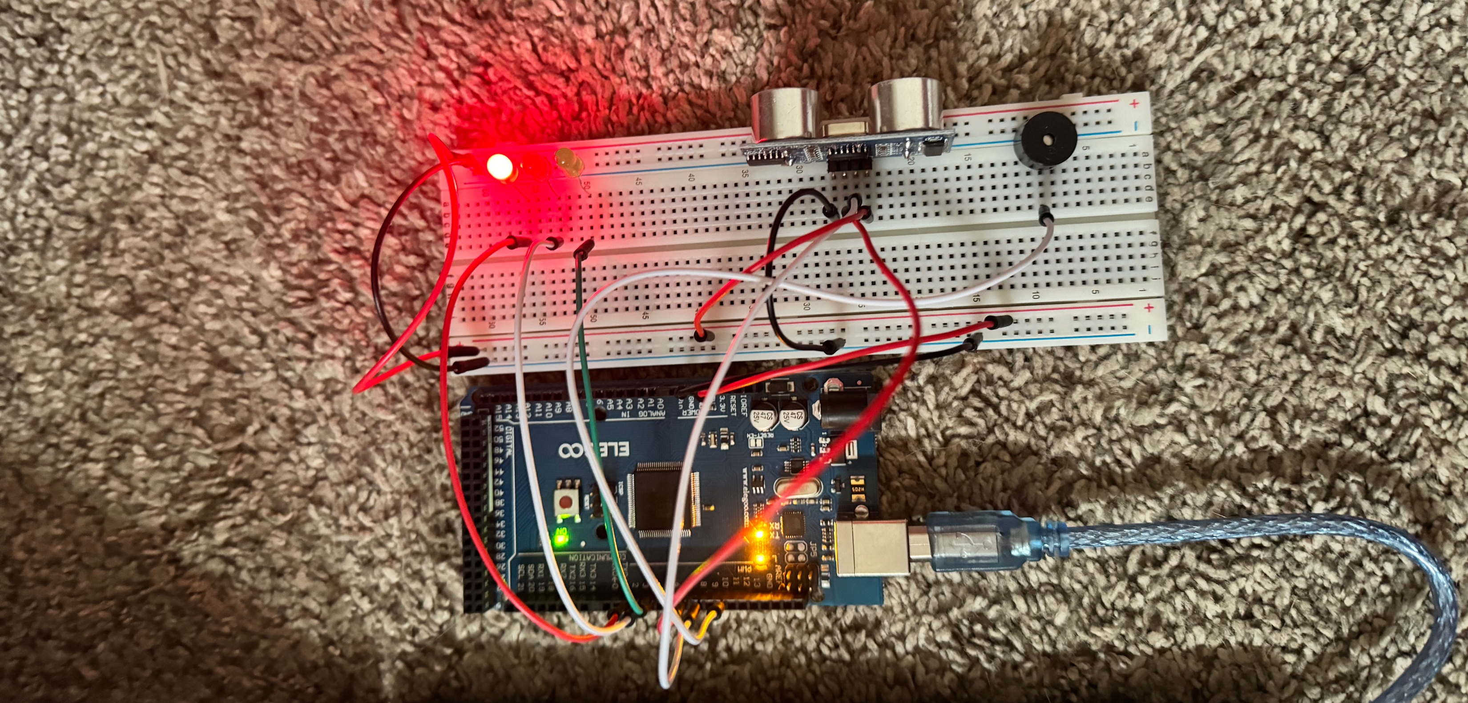
CIRCUIT WITH RED LED ON (PICTURE)

Slide 20
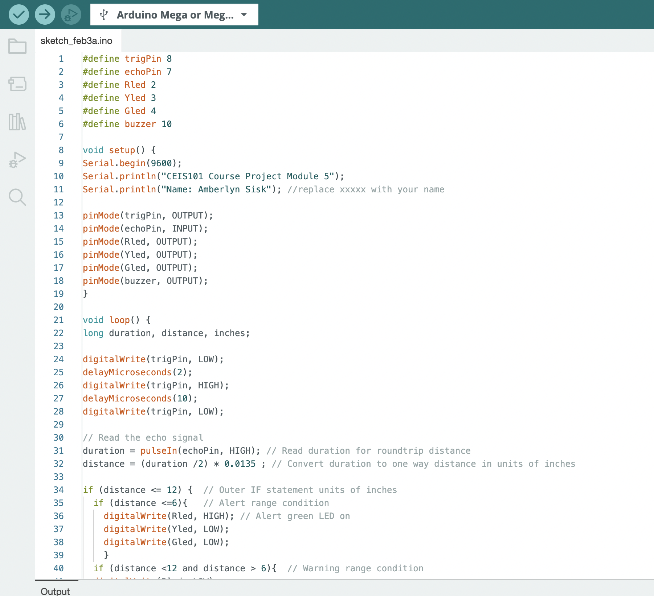
ARDUINO CODE (SCREENSHOT)

Slide 21
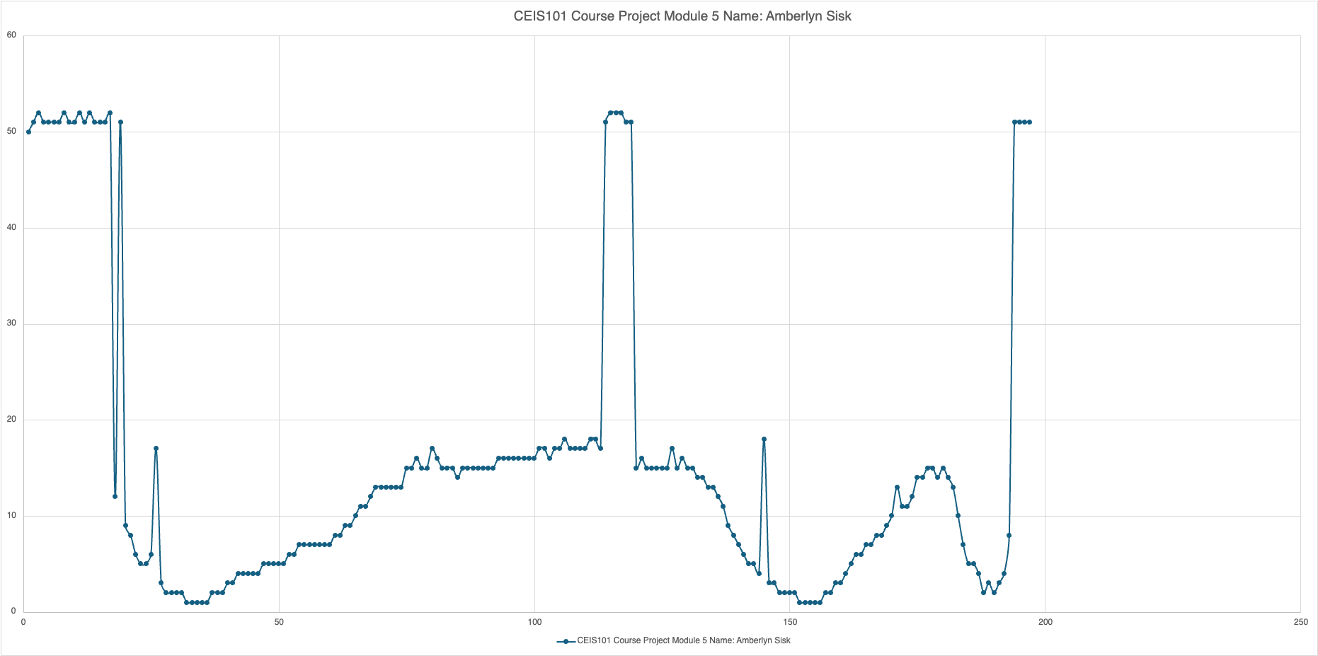
PLOT OF DATA (GRAPH FROM EXCEL)

Slide 22
MODULE 6 PROJECT: ADDING AUTOMATED LIGHT
In the final portion of this project, we added an automated light sensor and a blue LED to our circuits. The light sensor measures the level of light around it, and when it senses a low amount of light, will automatically turn on the blue LED.

Slide 23
CIRCUIT WITH AUTOMATED LED OFF (PICTURE)

Slide 24
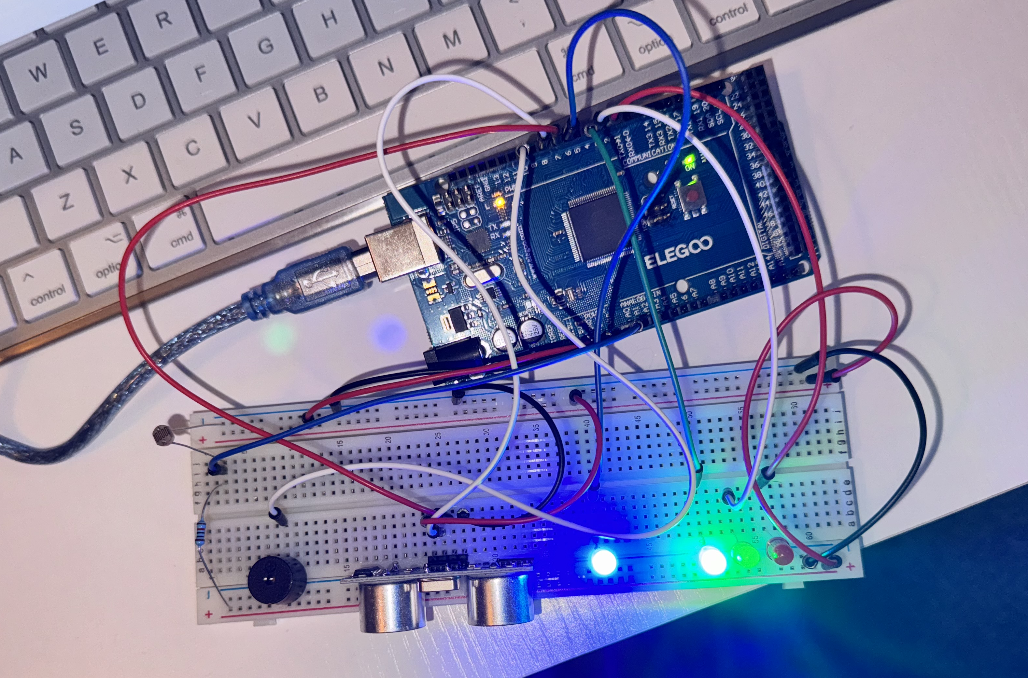
CIRCUIT WITH AUTOMATED LED ON (PICTURE)

Slide 25
ARDUINO CODE (SCREENSHOT)

Slide 26
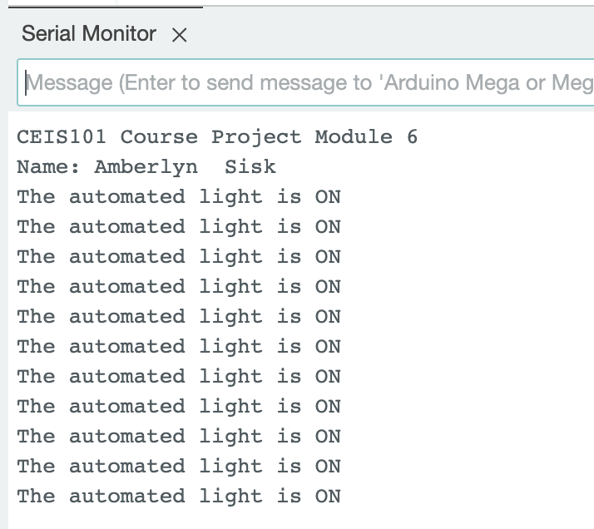
SERIAL MONITOR (SCREENSHOT)

Slide 27
CHALLENGES/LESSONS LEARNED
I use a MacBook Air for my schoolwork and had trouble hooking up the breadboard to the Arduino IDE. After some research, I was able to hook up the breadboard and complete my projects.
Coming from the software side of technology, diving in and working with hardware was daunting to me. Knowing what wires go where and figuring out how everything worked was challenging and exciting.
While the coursework and lesson plans were extremely helpful, I learned quickly that I had to do my own research to supplement the lessons being taught.

Slide 28
CAREER SKILLS
Becoming familiar with C++ programming utilized in the Arduino IDE will help with landing a software career. According to 6sense, there are currently 109,911 companies utilizing C++.
Becoming familiar with the hardware used in computers will prove invaluable for an IT position in any company. “As of June 2023, there are still over 3.97 million jobs for IT professionals in the US.” (Pydi, 2023)

Slide 29
CONCLUSION
CEIS101: Introduction to Technology and Information Systems was an exciting and challenging course. Learning the hardware needed to create our final project was both challenging and fun. Learning how to do my own research about the Internet of Things helped me learn much more beyond the lesson plans. Over the past 8 weeks, I took a kit of miscellaneous parts and built a smart home automation and security system, which is something that I would not have thought I could do before this course.

Slide 30
REFERENCES
(n.d.). C++. 6sense. Retrieved February 22, 2024, from https://6sense.com/tech/programming-language/cplusplus-market-share
Pydi, V. (2023, June 25). How many Jobs are available in Technology in the US? (Tech layoffs in 2023). LinkedIn. Retrieved February 22, 2024, from https://6sense.com/tech/programming-language/cplusplus-market-share
CEIS101 Module 1 Project Guide FINAL

Slide 31
LINK TO PORTFOLIO WEBSITE
Please follow the link to my portfolio website built using ReactJS.
https://amberlynsisk.com/

