Slide 1
Linux Operating Systems
CEIS106 Final Course Project
January 2024
Amberlyn Sisk
Professor Donna Jackson

Slide 2
Introduction
In this course, we learned a great deal about the Linux Operating System. This project focuses on Linux and Ubuntu with the use of a Virtual Machine. The following slides will utilize screenshots that showcase the following subjects:
Navigating the Linux filesystem tree
Creating shell scripts
Adding users and groups in CLI
System performance monitoring

Slide 3
Navigate the Linux filesystem tree
Create directories and files
Copy and remove directories and files
Locate directories and files

Slide 4
Create directories and files

Slide 5
Copy and remove directories and files

Slide 6
Locate directories and files

Slide 7
Create a shell script
Change script file permissions
Set the Path variable
Make the Path variable permanent

Slide 8
Change script file permissions

Slide 9
Set the PATH variable

Slide 10
Make the PATH variable permanent

Slide 11
Add users and groups in CLI
Test user and group settings
Add users in GUI
Remove users and groups

Slide 12
Test user and group settings

Slide 13
Add users in GUI

Slide 14
Remove users and groups

Slide 15
SYSTEM PERFORMANCE MONITORING
Discover host IP configurations
Use network utilities
Monitor bandwidth usage

Slide 16
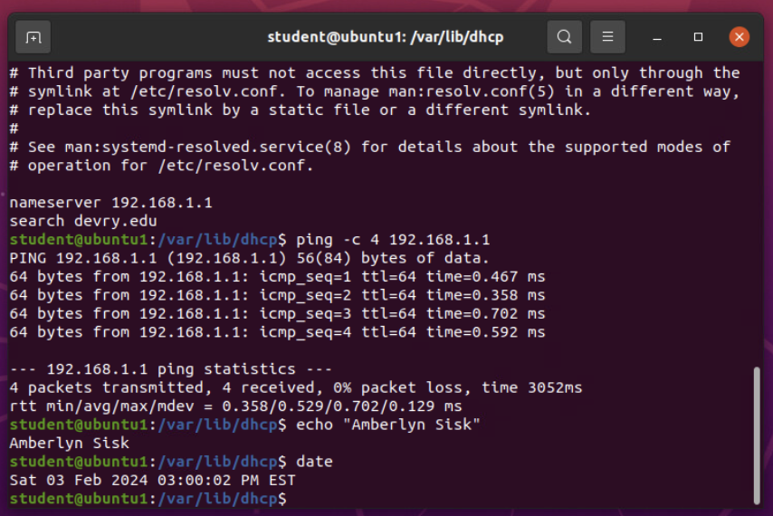
DISCOVER HOST IP CONFIGURATIONS

Slide 17
Use network utilities

Slide 18
Monitor network bandwidth usage

Slide 19
CHALLENGES FACED
Linux is case-sensitive, it is important to ensure you are using the correct casing for any command you are giving.
Remembering which commands to use takes repetition and practice. The instructions in the exercises helped immensely, however, you are not given step-by-step instructions in the real world.
This course covered a lot of information in a very short amount of time. I found myself going back to modules often to help retain the information taught.

Slide 20
CAREER SKILLS
In this course, we learned many skills that will help with careers within the computer science field. Some of those skills include:
The basics of creating scripts to automate tasks
Setting permissions for users, groups, and files
Managing IP configurations
Hands-on experience with the Linux terminal

Slide 21
Conclusion
CEIS106: Introduction to Operating Systems was an invaluable and fast-paced course. We learned what an Operating System is and took a deeper dive into the Linux OS. We got hands-on experience with the Linux OS by utilizing Virtual Machine labs. I can take what I learned from this course and build on the skills I have gained in my future DeVry courses.

Slide 22
Link to portfolio website
Please follow the link to my portfolio website built using ReactJS.
https://amberlynsisk.com/

