Slide 1
Python Data Analysis
CEIS110: Final Course Project
March 2024
Amberlyn Sisk
Professor Omar Haddad

Slide 2
Introduction
IoT sensors, mobile devices, and websites generate large amounts of data that can be analyzed and turned into information to assist companies with decision-making.
Using Python, this course project analyzes weather data downloaded from a cloud data source. The data is then stored in a database, extracted, and then processed. This course project includes planning, software setup, programming using Python, and data analysis using graphs.

Slide 3
Design and Setup
Planning the design of your software development project is an extremely important part of the development process. A flowchart is created before starting a process to determine the logical flow before any code is executed. Common flowchart symbols are shown below.
Process
Display
Decision
Termination
Connector

Slide 4
Flowchart
Includes the following processes:
Run a basic Python program
Download weather data to a database.
Query the weather data
Extract weather data from database into a comma separated file with python
Cleanse weather data
Use Python data analytics modules to develop graphical models

Slide 5
Basic Python Program
After creating a flowchart documenting the process of our weather data analysis program, we were tasked with creating a basic Python program. This program takes three user inputs: name, city, and temperature. The program then uses a conditional statement that reads the inputs and outputs one message if the temperature is over 60 degrees and another if the temperature is under 60 degrees.

Slide 6
Python Program (Screenshot)

Slide 7
Downloading Weather Data
The US National Oceanic and Atmospheric Administration (NOAA) provides free access to nationwide weather observations via a cloud-based API. In this part of the course project, we created a Python program that downloaded a data set of recent weather observations for our current locations. This Python program creates a database on our computer’s hard drive and stores the data in a table for future use.

Slide 8
BuildWeatherDb.py Code (Screenshot)
Screenshot of code in Spyder

Slide 9
Python Console (Screenshot)
Screenshot of program output in Python console showing program executed successfully

Slide 10
Weather.db File (Screenshot)
Screenshot of Windows Explorer showing database file Weather.db was created

Slide 11
Querying the database with SQL
Structured Query Language (SQL) is a specialized programming language for working with relational databases. Python allows users to utilize SQL commands to receive and display results to the user. In this part of the course project, we used Python to issue SQL query commands to the database we previously created and view the results. The first SQL query command shows us all of the data stored in the database, the second shows us only the lowest and highest temperatures, and the third shows us only the days that were clear.

Slide 12
Query to retrieve all columns and all rows (Screenshot)
Screenshot of SQL query command and results

Slide 13
Query to retrieve lowest and highest temperatures (Screenshot)
Screenshot of SQL query command and results

Slide 14
Query to retrieve all clear days (Screenshot)
Screenshot of SQL query command and results

Slide 15
Querying and Manipulating data with SQL and Python
One of the most important concepts a programmer should understand is how to work with lists. The data stored in a database table can be read into a list and processed by Python. The data must be cleansed of any missing data to ensure the data is complete, valid, and standardized. After the data is cleansed, it is then sorted and written into a comma-separated values (CSV) file that can be read by Excel.
The following code retrieves the temperature and humidity values and writes them into a CSV file.

Slide 16
Python Code (Screenshot)
ExtractTempHumidity.py Python code

Slide 17
Retrieve and Convert Data to CSV Format (Screenshot)
Formatdata file open in Excel showing 3 columns of data

Slide 18
Graphing Data
Excel allows you to create certain graphs with selected information. The following slide shows a temperature and Humidity 2-D line chart. The data represented in this chart is roughly one week's worth of weather data.
Converting data into visual aids, like charts, is a great way to easily compare data and predict trends in the data.

Slide 19
Temperature and Humidity Chart (Graph)
Excel chart based on temperature and humidity data from database

Slide 20
Develop Graphical Models and Interpret Results
In this final part of the course project, we utilized a data analytics module in Python, called pandas, and a Python library, called matplotlib, to create plots of our data. We used these visual plots of information to compare and analyze the weather data we collected earlier in the project.
First, you will see a line graph comparing week 1 and week 2 temperature data in Celsius. Next, you will see a histogram of humidity data.

Slide 21
Plot #1
Plot and code used to generate it
Line

Slide 22
Plot #2
Plot and code used to generate it
Histogram

Slide 23
Analysis of Data
After learning how to create visual plots using pandas and matplotlib in Python, we were tasked with creating our own plots and making an analysis of the data shown.
I created two box plots showing the variations of temperature and humidity between two different weeks and made an analysis based on what was shown in the plots.

Slide 24
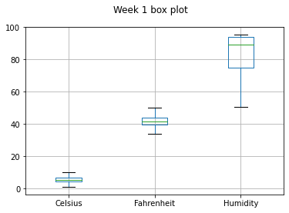
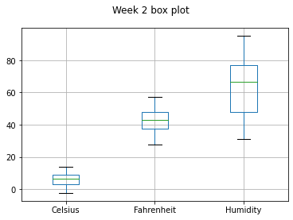
Analysis
Week 1 had far fewer variations than week 2 had in both temperature and humidity.

Slide 25
Prediction
Develop a prediction based on the data. What variations in temperature and humidity do you expect over the next few hours or days? How would humidity change if the temperature goes up or down?
I predict that the temperature and humidity will rise over the next few weeks. Based on the line graph on slide number 3, the temperature was up quite a bit in week 2 and I expect that the temperature will continue to trend in that direction.

Slide 26
Conclusion
Knowing the basics of Python code is valuable in itself, however, understanding how to store and analyze data using Python is a truly valuable skill to many employers.
We not only learned the basics of Python code in this course but how to use the code in a real-world application. We were able to plan our projects using flowcharts and download, query, and analyze data using charts.

Slide 27
Challenges During Project
While I had a base knowledge of Python going into this course, the challenges I faced while completing this project I faced were:
Learning how to convert data to a CSV file.
Learning how to utilize pandas and matplotlib.
Using Spyder IDE, as I have only used Visual Studio Code in the past.

Slide 28
Career Skills
Completing a program from start to finish, beginning with the planning stage.
Understanding of how to use Python to analyze data.
Using SQL query commands with Python code.
Using Python libraries, such as matplotlib.
Plotting weather data to analyze and make predictions.

