Slide 1
Traffic Light Controller
CEIS114: Introduction to Digital Devices
Amberlyn Sisk
May 2024
Professor Mostafa Mortezaie

Slide 2
Introduction
In this course, we designed and developed a two-way traffic light controller, secured the system to be controlled remotely via a web browser, and integrated a SMART sensor to trigger signal changes based on traffic flow.
This course project was built using Wokwi. The following slides will show our step-by-step process to create the traffic light controller.

Slide 3
Project Plan for IoT Traffic Controller
The first part of this project was getting familiar with the Wokwi interface. We laid the basic foundation for our traffic light controller, which we will add onto throughout the project. This portion of the project includes:
Half Bread Board
ESP 32 Board

Slide 4
ESP32 (Screenshot)
Microcontroller mounted and powered ON

Slide 5
ESP32 WiFI Scan
Screenshot of Serial Monitor showing the available networks

Slide 6
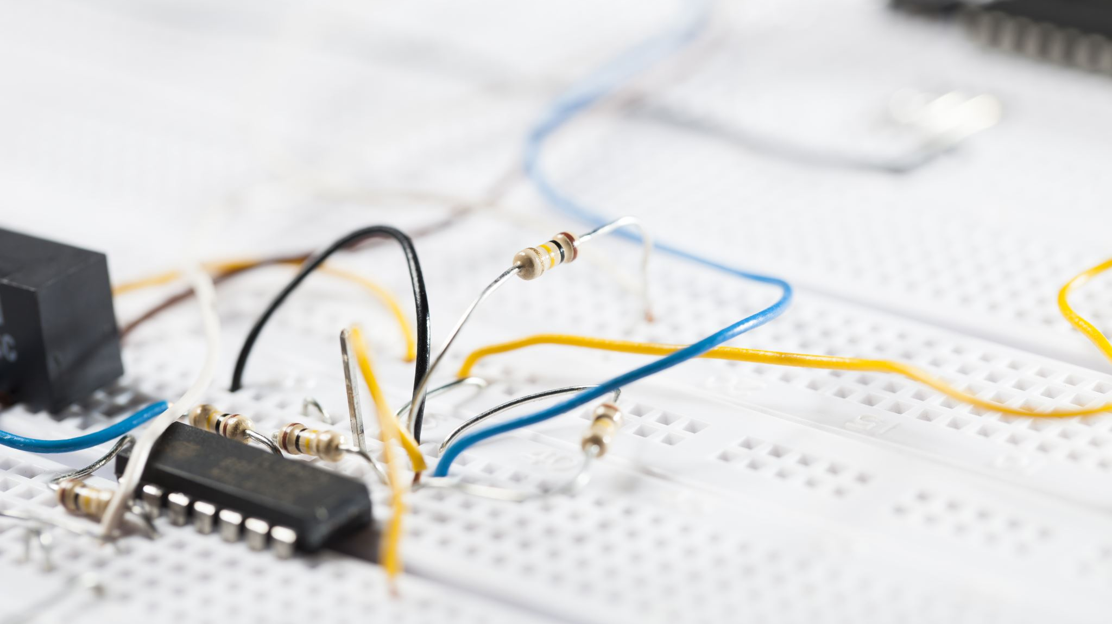
Creating the Traffic Controller
In this portion of the project, we utilized Wokwi to create the basic lighting of our traffic light controller. The components of this portion include:
ESP 32 Board
Full Breadboard
Half Breadboard
Wires
Red, Yellow, and Green Colored LEDs
We then used the Wokwi code editor to enable the colored LEDs to flash.

Slide 7
Picture of circuit with working LEDs
ESP 32 Board
Colored LEDs: Red, Yellow, and Green
Wires
Breadboard

Slide 8
Screenshot of code in the Code Editor

Slide 9
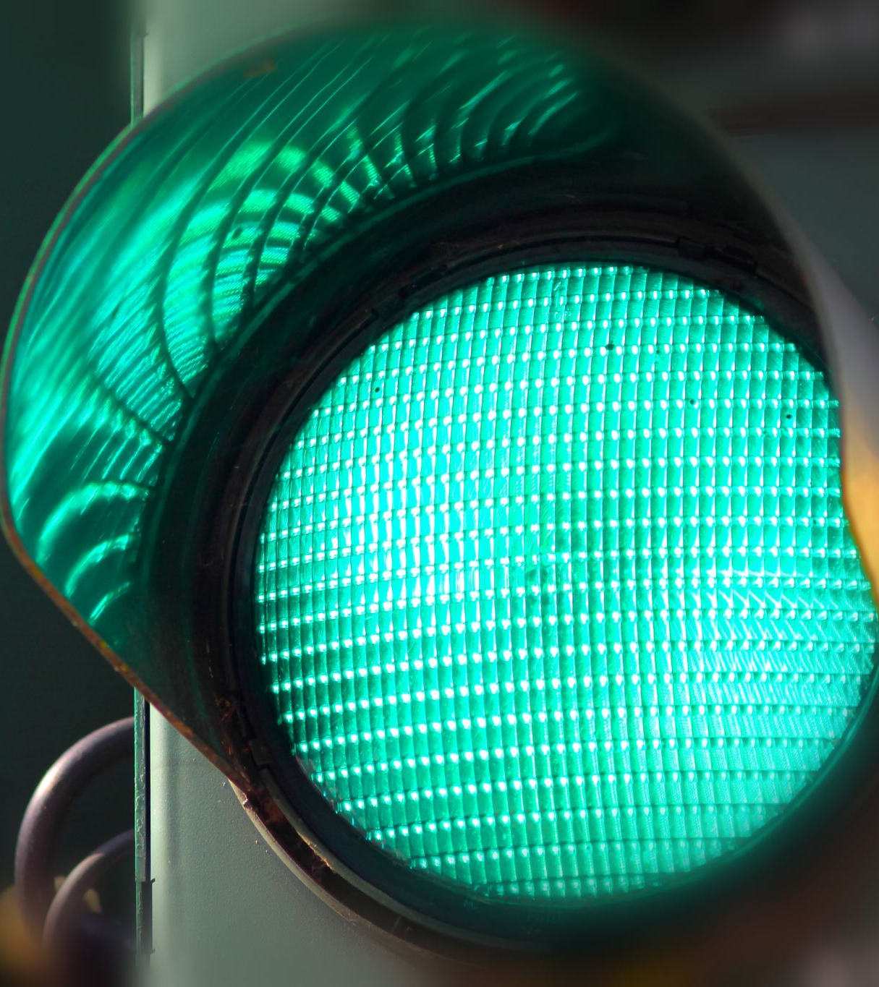
Creating Multiple Traffic Light Controller
The next step in this project was to add another set of LED lights to act as our second traffic light. One set of LEDs will keep the red light on as the other set cycles through the green, yellow, and red lights. Then the set will switch and continue on this loop until we end the simulation.

Slide 10
Picture of circuit with working LEDs
ESP 32 Board
Colored LEDs: Red, Yellow, and Green (two sets)
Wires
Breadboard

Slide 11
Screenshot of code in Wokwi

Slide 12
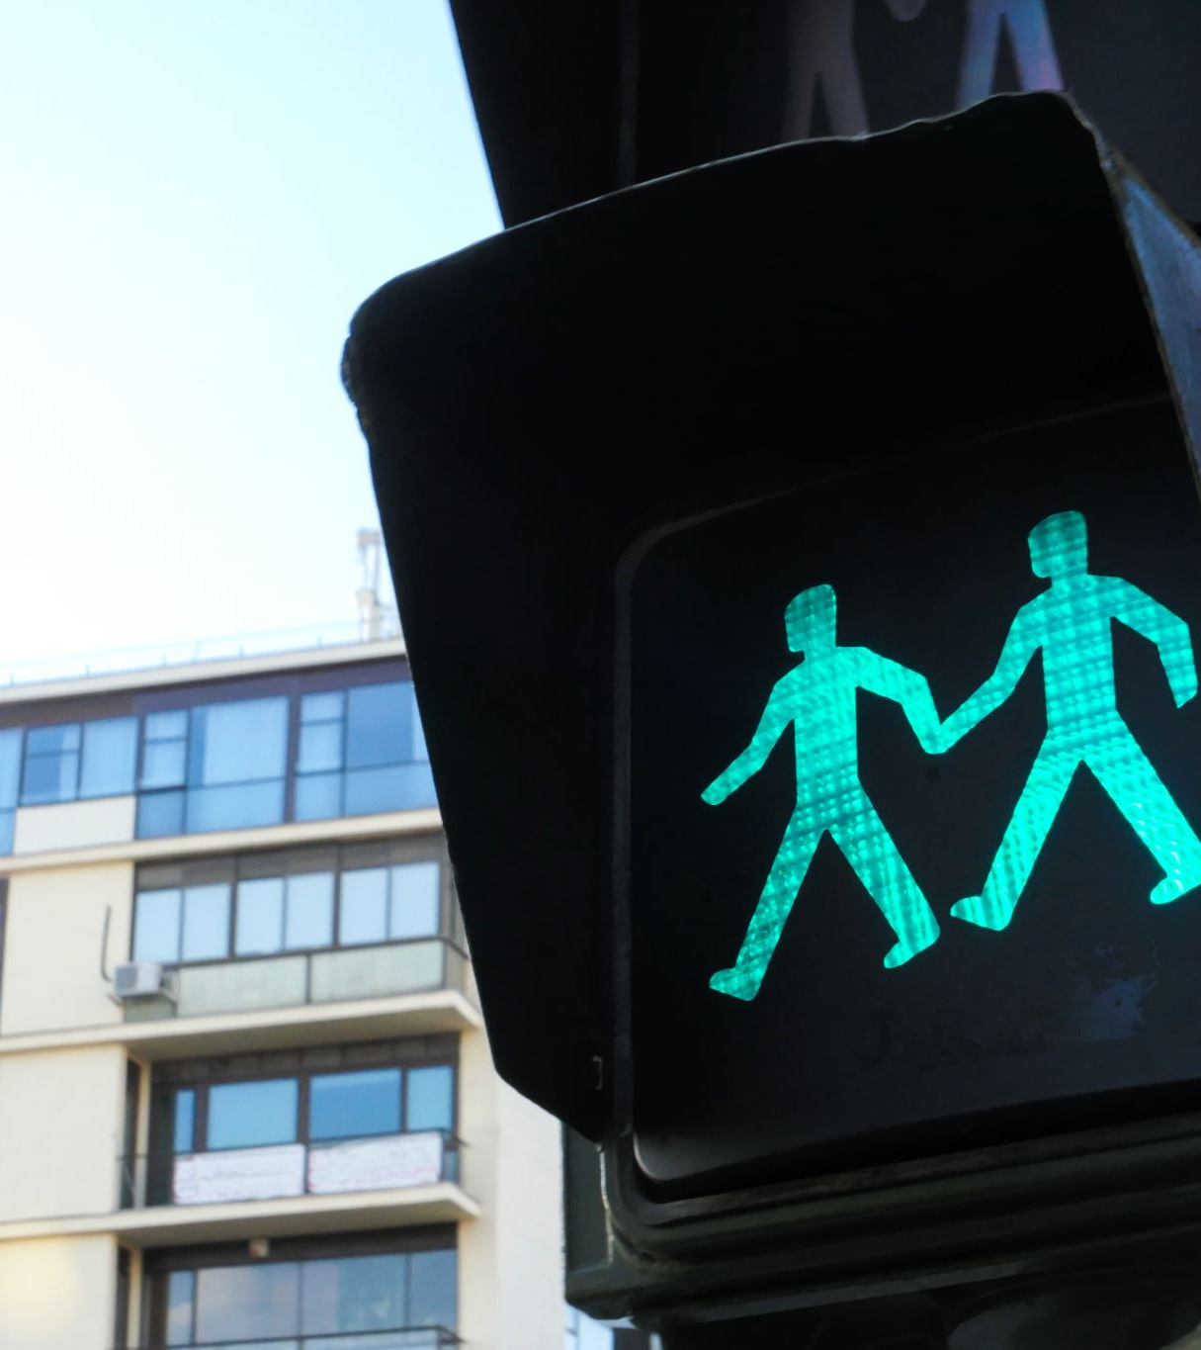
Creating a Multiple Traffic Light Controller with a Cross Walk
In this part of the project, we added a push button to act as our crosswalk button that pedestrians can push to safely cross the street. After pushing this button, the pedestrian is given 10 seconds to cross the street safely, while both traffic lights are turned red.

Slide 13
Screenshot of circuit with working LEDs
ESP 32 Board
Colored LEDs: Red, Yellow and Green (two sets)
220 Ohm Resistors (optional)
Push Button
Wires
Breadboard

Slide 14
Screenshot of code in Wokwi

Slide 15
Screenshot of Serial Monitor in Wokwi
Screenshot of output in Serial Monitor

Slide 16
Creating a Multiple Traffic Light Controller with a Cross Walk and an Emergency Buzzer
One of the final steps of this project was adding an LCD unit with a message display and a buzzer to signal to pedestrians when it is safe to cross the street.

Slide 17
Picture of circuit with working LEDs and LCD display
ESP 32 Board
Colored LEDs: Red, Yellow and Green (two sets)
220 Ohm Resistors (optional)
Push Button
LCD Unit with Message Display
Wires
Breadboard

Slide 18
Screenshot of code in Code Editor

Slide 19
Screenshot of Serial Monitor
Screenshot of output in Serial Monitor

Slide 20
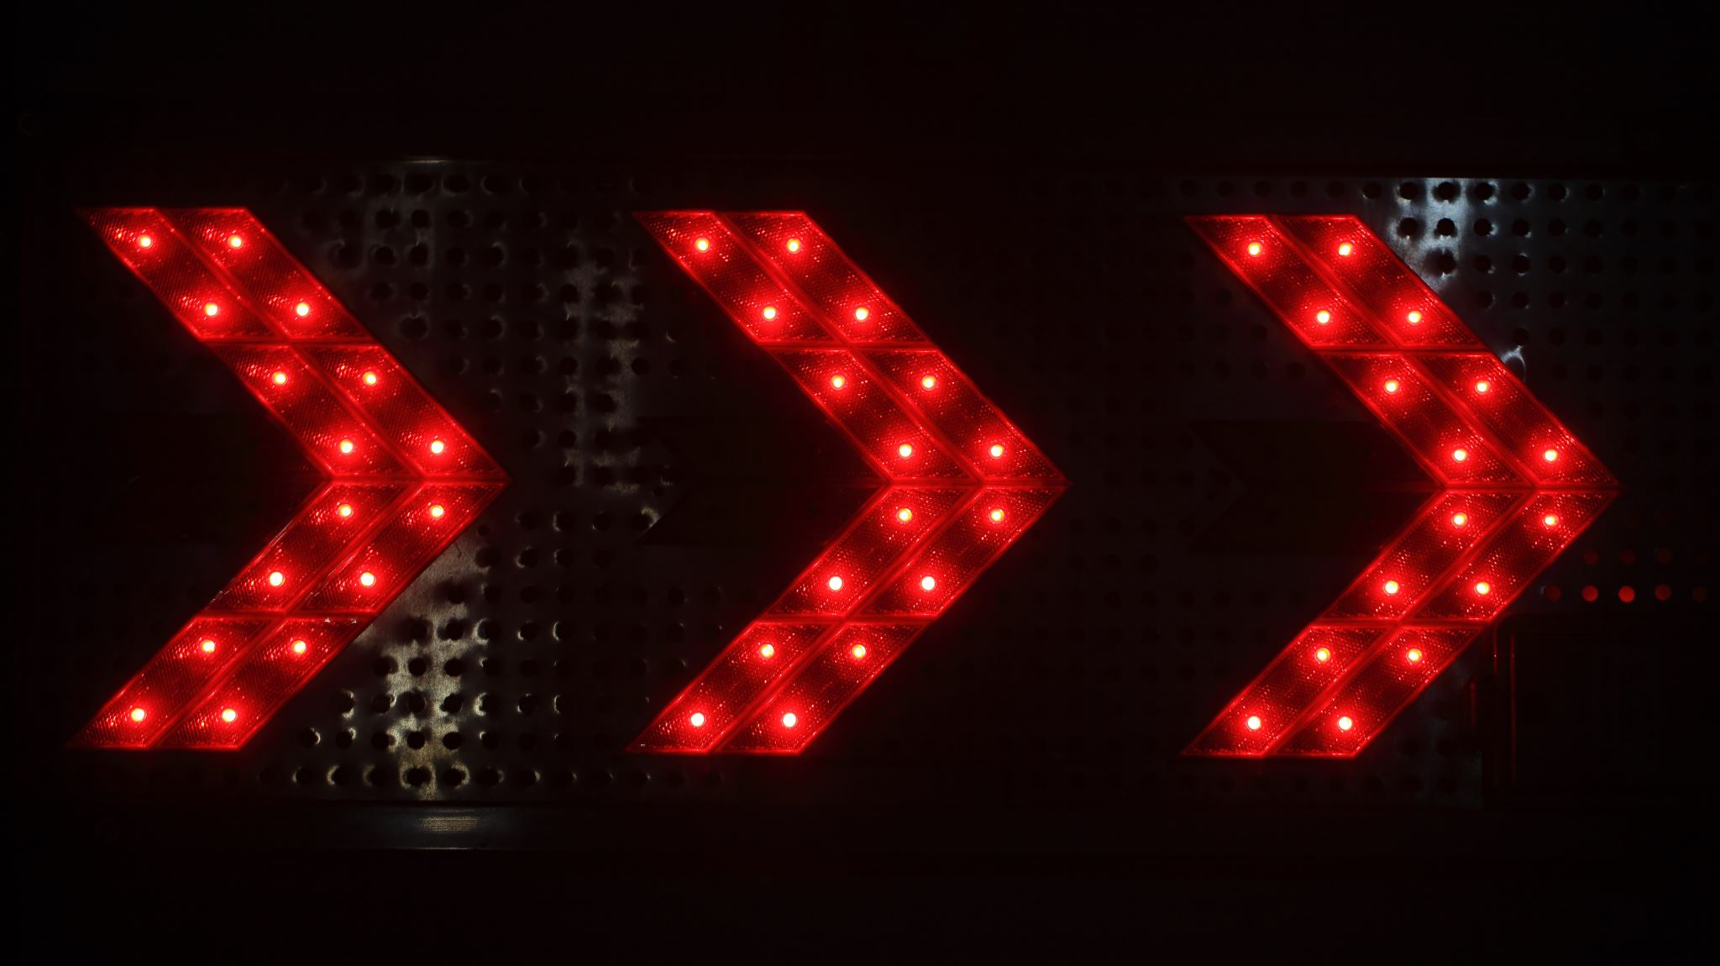
Creating a Multiple Traffic Light Controller with a Cross Walk and an Emergency Buzzer with secured IoT Control via Web
The final part of assembling our traffic light controller was to add a blue LED light to indicate an emergency. This light was controlled via the IoT MQTT Panel application that was installed on my iPhone. When the emergency button is pushed within the application on my phone, the buzzer sounds, both traffic lights turn red, and the LCD message board displays an ”EMERGENCY” message.

Slide 21
Screenshot of circuit with working LEDs and LCD display (Building/Operation)
ESP 32 Board
Colored LEDs: Red, Yellow and Green (two sets)
One Blue LED – Emergency Light
Push Button
LCD Unit
Buzzer
Wires
Breadboard

Slide 22
Screenshot of code in Code Editor (Testing)

Slide 23
Screenshot of Serial Monitor (Testing)

Slide 24
Challenges
While working with IoT kits and code are not new to me, Wokwi was a new technology for me to learn. The video guides within each module made the learning process easy and helped me understand what was being added to the project and why.

Slide 25
Career Skills
The world of IoT is growing at a very fast pace, and understanding how to utilize technology in the world of IoT is very important to any career in technology going forward. This course helped us prepare to build real-world applications that any employer would love to see.

Slide 26
Conclusion
With the development of modern cities and urban areas, the need for smooth-flowing pedestrian and vehicle traffic has been growing. This course project taught us how to build a traffic light controller system that included an emergency signal and a pedestrian crosswalk button. The skills we learned in this course are invaluable.

Slide 27
Refernces
For this project, the only references I utilized were the course project guides and course project video tutorials.

