Slide 1

Networking in the World of IoT
NETW191: Final Course Project
March 2024
Amberlyn Sisk
Professor Donald McCracken

Slide 2
Intro
This project covers the fundamentals of networking that play a vital role in the world of IoT. The following slides will cover:
SOHO router configurations
Subnetting
connectivity testing
network documentation
SOHO wireless network security.

Slide 3
IPv4 Addressing
The objective of this module was to implement an IPv4 addressing scheme to support a network. We achieved this by assigning an IPv4 address to the SOHO Router virtual machine within the Infosec Learning Lab.
A SOHO router is the core network hardware device used to build a small home or office LAN. Devices connected to the SOHO router typically get an IP address and other network configuration parameters from the SOHO router’s DHCP server.
To manage the SOHO router, we used the Firefox browser on Computer 1 to access the router’s default management interface. To obtain the IP address that was input into the browser address bar, we first used the command ip route | grep default in the terminal. We were then able to edit the LAN settings and update the IPv4 address and the IPv4 netmask.

Slide 4
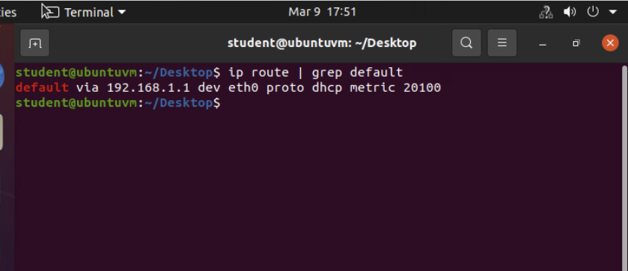
Preparation
This screenshot includes the terminal window that shows the default gateway IP address.

Slide 5
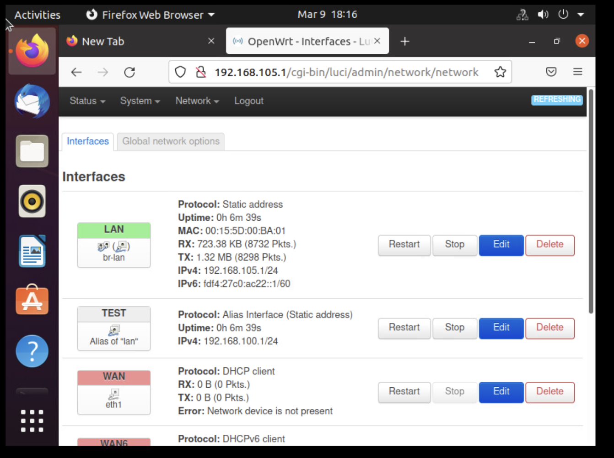
IPv4 Address Assignment
This screenshot includes the Interfaces page that shows the new IPv4 address on the LAN interface.

Slide 6
Connectivity Test
The objective of this module was to test connectivity between Computer 1 VM, Computer 2 VM, and the SOHO Router. With the SOHO Router as the DHCP server, the Computer 1 and Computer 2 VMs will have their IPv4 addresses on the same network.
We first checked the IP addresses of both Computer 1 and Computer 2 by using the command ip addr in each terminal. Doing this showed the IP address of 192.168.105.228/24 for Computer 1, and the IP address of 192.168.105.230/24 for Computer 2.
We then checked the connectivity of the SOHO Router, Computer 1 and Computer 2 by using the ping command in each terminal followed by the SOHO Router’s IP address and the opposite computer’s IP address.

Slide 7
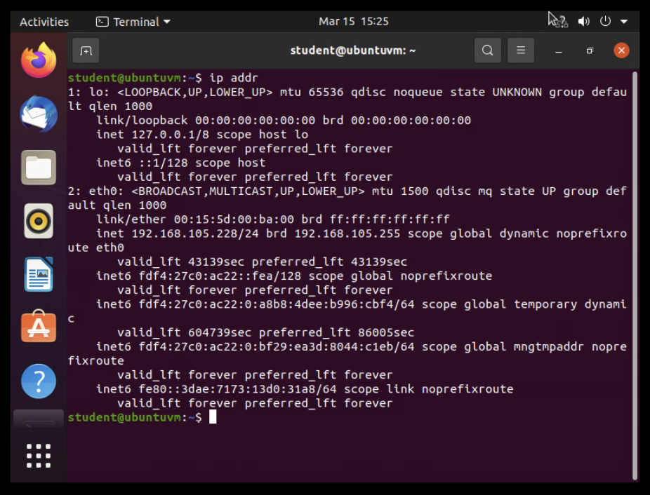
Dynamic IP Address Assignment
This screenshot shows the IPv4 address of Computer 1 VM.

Slide 8
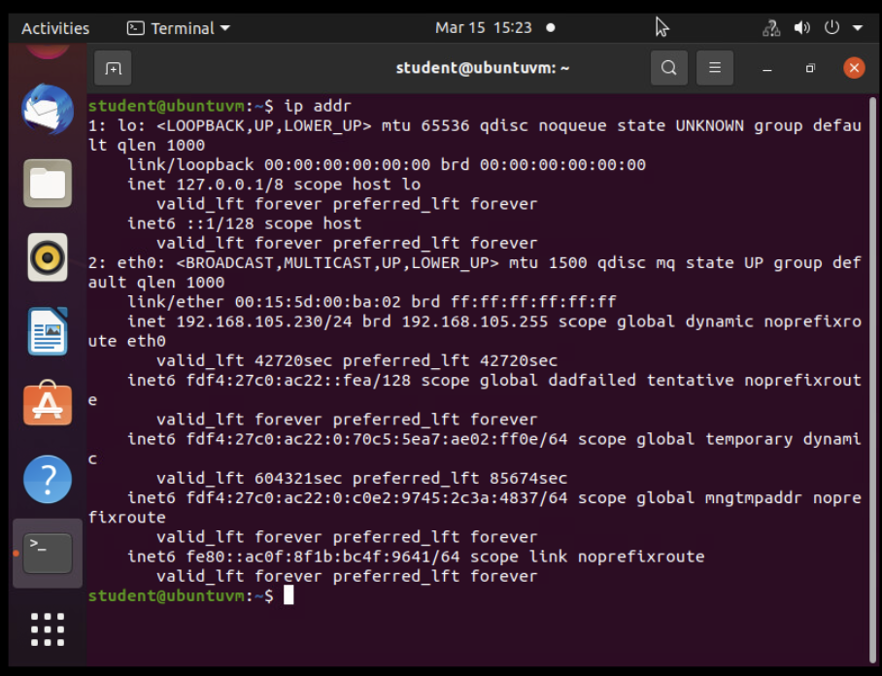
Dynamic IP Address Assignment
This screenshot shows the IPv4 address of Computer 2 VM.

Slide 9
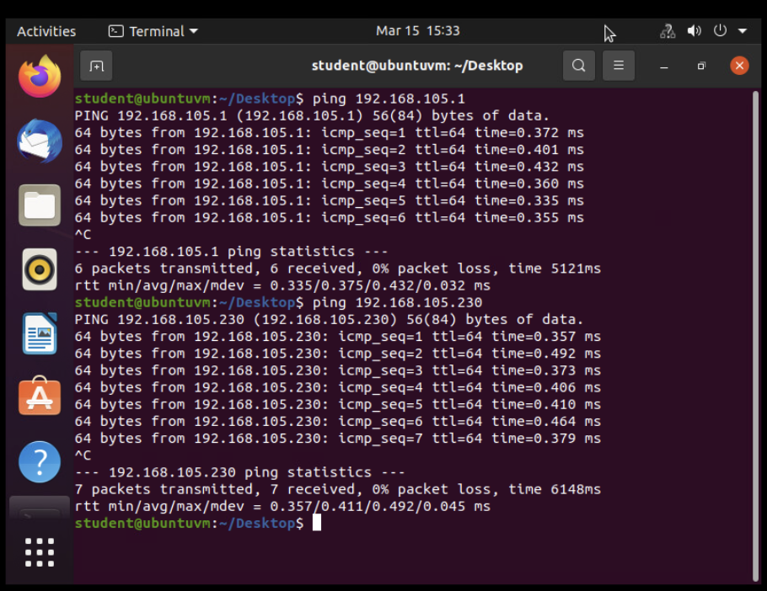
Connectivity Test
This screenshot shows 1) the connectivity test FROM the Computer 1 VM TO the SOHO Router VM, and 2) the connectivity test FROM the Computer 1 VM TO the Computer 2 VM.

Slide 10
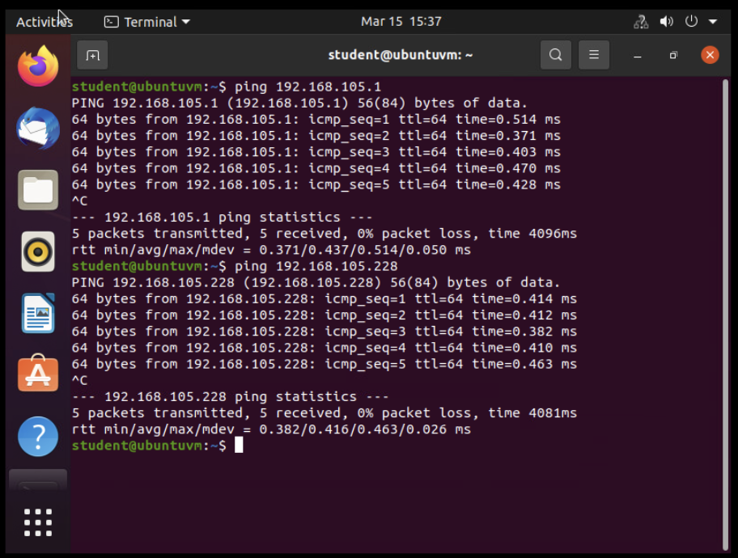
Connectivity Test
This screenshot shows 1) the connectivity test FROM the Computer 2 VM TO the SOHO Router VM, and 2) the connectivity test FROM the Computer 2 VM TO the Computer 1 VM.

Slide 11
IP Subnetting and Loopback Interfaces
To be functional on an IP network, a host requires a unique identifier known as an Internet Protocol (IP) address. The first IP address of a subnet block represents the subnet itself. Routing devices use that address in their routing tables to reach the destination network. The last IP address of the block represents the broadcast address to which a packet can be sent to reach all hosts on the same subnet. The addresses between these two (i.e., the network address and the broadcast address) are the usable host addresses that can be assigned to hosts.
In this module, we performed IP subnetting as shown in the table on the next slide. We then added two loopback interfaces to Computer 1. Lastly, we pinged both loopback interface IP addresses to ensure they were connected correctly.

Slide 12
IP Subnetting
This table includes two /25 subnets, listing
Subnet notation
Network address
First usable host address
Last usable host address
Broadcast address

Slide 13
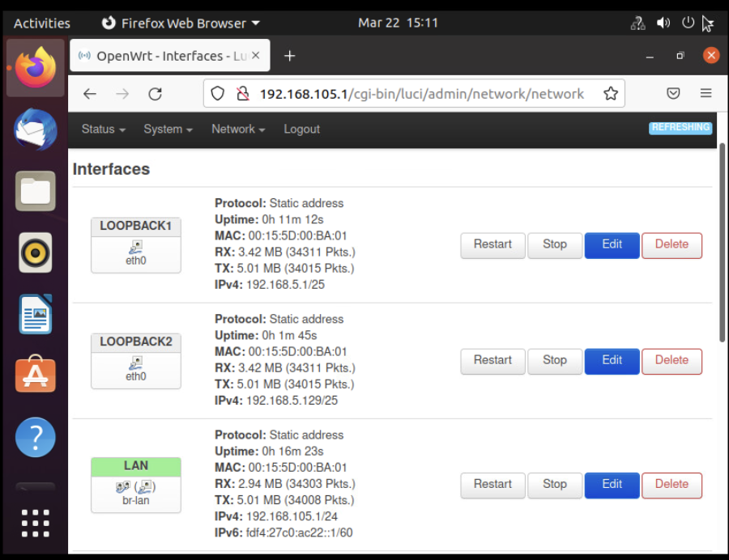
Loopback Interfaces
This screenshot shows both Loopback1 and Loopback2 interfaces and their correct IPv4 addresses.

Slide 14
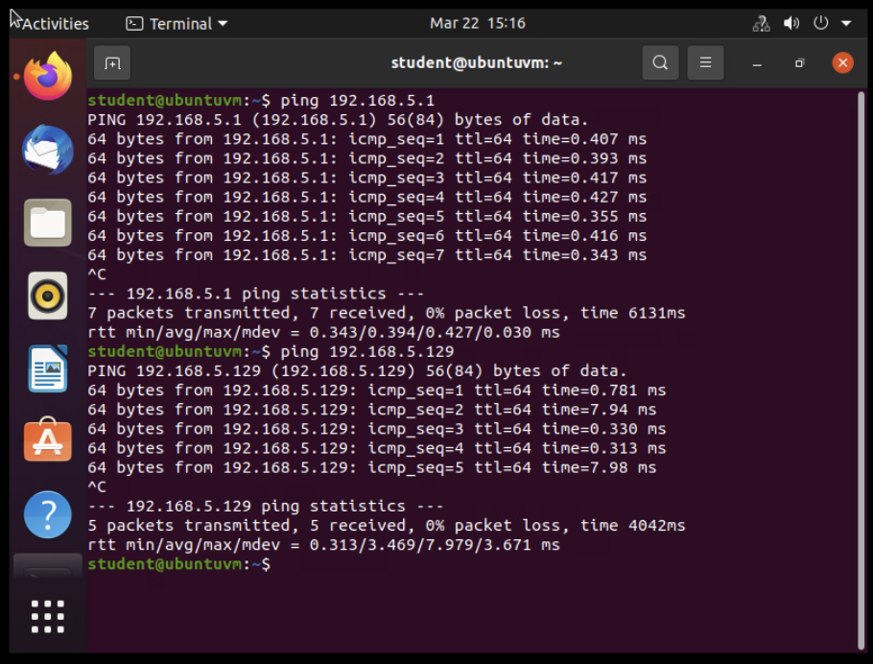
Connectivity Tests
This screenshot shows two successful ping tests:
from the Computer 1 VM to the Loopback 1 interface
from the Computer 1 VM to the Loopback 2 interface

Slide 15
Visio Network Diagram
In this module, we created a network diagram showing the connections between Computer 1 VM, Computer 2 VM, and the SOHO Router VM.
We were asked to use Visio for this project, as I am using a Mac computer, I opted to use Lucid Chart for this project as an alternative.
All pieces of this network diagram are labeled with IP addresses and names of what each icon is depicting.

Slide 16
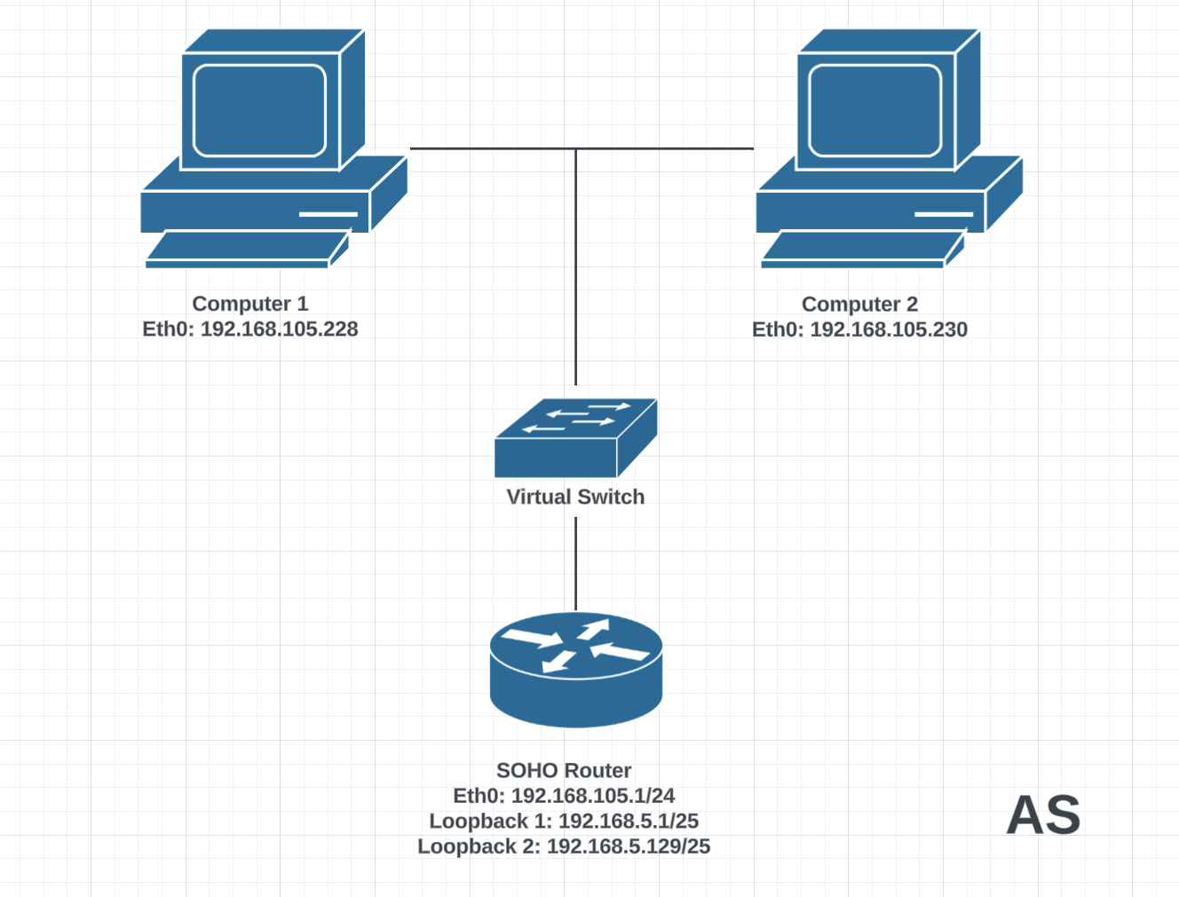
Microsoft Visio Network Diagram
This diagram illustrates the interconnection of the Computer 1 VM, the Computer 2 VM, and the SOHO Router VM along with proper IP addresses and labeling.

Slide 17
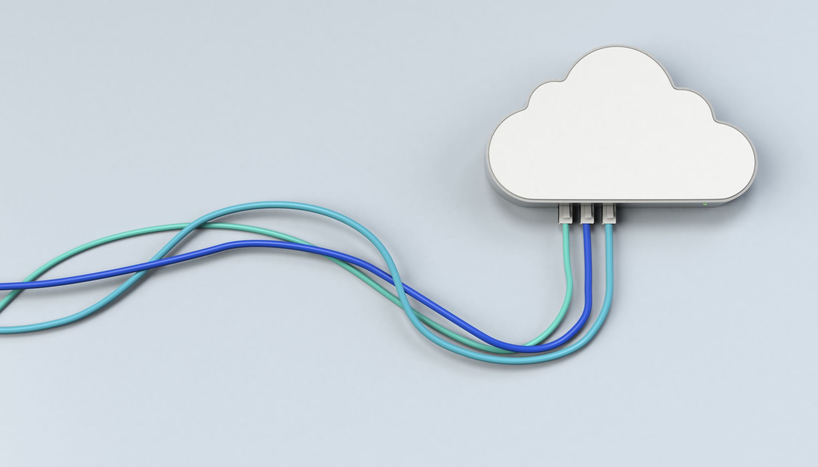
SOHO Wireless Network Security
In this module, we explored router configurations that could be used to add protection to a SOHO network. We explored these configurations at https://www.tp-link.com/us/support/emulators. We found the default username and password for the router, explored static and dynamic IP assignments, learned about MAC filtering, and looked at Wi-Fi security protocols.

Slide 18
SOHO Wireless Network Security 1 of 3
1. What are the factory default username and password of a TP-Link router? Why is it important to change the default username and password of a SOHO router?
Answer: The factory default username and password of a TP-Link router are both “admin”. It is important to change the username and password of a SOHO router to protect your router from being hacked.
2. To protect a SOHO wireless network with a small number of devices, which address management method provides more control, configuring the device IP addresses manually (static IP) or using a DHCP server (dynamic IP)? Why?
Answer: Configuring a SOHO wireless network manually with a static IP address provides more control. “While static IPs offer more control over network access and can be used for remote access, they do have their drawbacks as well. On the other hand, dynamic IPs can provide better security but with a lack of control over who has access to the network.” (Popovici, 2024)

Slide 19
SOHO Wireless Network Security 2 of 3
3. What does MAC filtering do? If needed, when would you use deny filtering rules and when would you use allow filtering rules? What happens to devices that want to connect, if the “Allow the stations specified by any enabled entries in the list to access” function is enabled but there are no entries in the list?
Answer: MAC filtering allows you to control the wireless stations accessing the AP. You would deny filtering rules to block specific devices, and you would allow filtering rules to let only certain agreed devices connect. If the “Allow the stations specified by any enabled entries in the list to access” function is enabled but there are no entries in the list, no wireless stations can access the AP.
4. What wireless security settings are displayed on the Wireless Security page? Which one is recommended by the vendor? Why?
Answer: The wireless security settings that are displayed are: Disable Wireless Security, WPA/WPA2 – Personal, WPA/WPA2 – Enterprise, and WEP. WPA/WPA2– Personal is recommended by the vendor because you select WPA based on a pre-shared passphrase. This allows you to choose a version, encryption type, wireless password and a group key update period.

Slide 20
SOHO Wireless Network Security 3 of 3
5. Among the configurations you explored in this module, which one is a true security function? Why?
Answer: Among all of the configurations explored in module 6, I believe that the Wireless Security function is a true security function. This is because the function allows you to choose what security measures you would like to use for wireless stations to be able to connect with proper encryption.
6. What would you do to protect your wireless network at home? Why?
Answer: At home, I use a VPN service to protect my network. I do this to protect myself against possible hackers that would want to steal mine or my family’s information.

Slide 21

Challenges
Challenges during this course included:
Learning how to utilize and assign IP addresses
Finding the correct IP address after using the ip addr command, as there is a lot of information given after the command is sent
Learning about SOHO networks was a learning curve for me as well.

Slide 22
Career Skills
In this course, we learned the necessary skills to pass the CompTIA Network+ certification exam. The skills we learned include:
Networking Fundamentals
Networking Implementations
Network Security
Network Troubleshooting
Obtaining the CompTIA Network+ certification is something that employers seek in careers such as Network Engineer, Network Administrator, IT Consultant, Network Analyst, and more.

Slide 23
Conclusion
This course taught many valuable lessons regarding networking including IP addressing, testing connectivity, IP subnetting, loopback interfaces, network diagramming, and SOHO wireless network security.
During this course, I was able to discuss with my classmates the various lessons that were studied over the last eight weeks.
Networking is a vital part of the world of the IoT. Being able to connect IoT devices safely and securely will ensure the world of IoT continues to work smoothly.

Slide 24
References
(n.d.). DeVry NETW 191 - Module 2: IPv4 Addressing. Infosec Learning. Retrieved March 9, 2024, from https://lab.infoseclearning.com/course/NMMQQFKYZF/lab/TJWARTLHFQ?check_logged_in=1
Leslie (2023, December 29). What Is a SOHO Network and How to Set up One? Infosec Learning. Retrieved March 9, 2024, from https://www.qsfptek.com/qt-news/what-is-a-soho-network-and-how-to-set-up-one#:~:text=Cost%2DEffectiveness%3A%20Devices%20used%20in,contributing%20to%20lower%20switch%20costs.
(n.d.). DeVry NETW 191 - Module 3: Connectivity Test. Infosec Learning. Retrieved March 15, 2024, from https://lab.infoseclearning.com/course/NMMQQFKYZF/lab/GUBMSVYPGQ?check_logged_in=1
(n.d.). DeVry NETW 191 - Module 4: IP Subnetting and Loopback Interfaces. Infosec Learning. Retrieved March 22, 2024, from https://lab.infoseclearning.com/course/NMMQQFKYZF/lab/CEIBZIYQSY?check_logged_in=1
NETW191 Module 5 Course Project Guide
Popovici, M. (2024, January 25). Static Vs Dynamic IPs: Differences, Similarities and Cybersecurity Considerations. Heimdal. Retrieved April 7, 2024, from https://heimdalsecurity.com/blog/static-vs-dynamic-ips/#:~:text=While%20static%20IPs%20offer%20more,has%20access%20to%20the%20network.

