Slide 1

Information System Security
SEC285: Final Course Project
May 2024
Amberlyn Sisk
Professor Kevin Moore

Slide 2
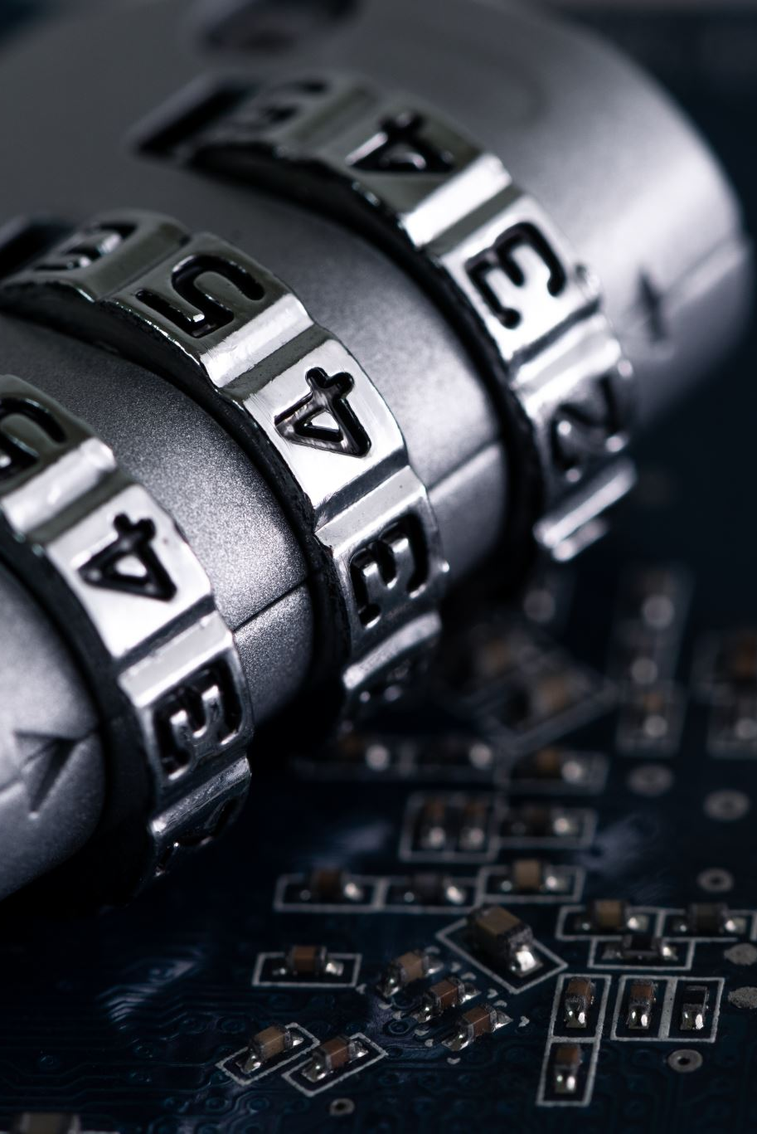
Introduction
This course covered the fundamentals of information security. The configuration and testing process in the Microsoft Hyper-V environment includes encryption, stateful firewall, multiple-factor authentication, and vulnerability assessment.
We also concluded this course with preparation for the CompTIA Security+ Certification test.

Slide 3

Asymmetric Key Encryption
GNU privacy guard (GPG) is an open-source implementation of the pretty good privacy (PGP) asymmetric encryption protocol. It uses a pair of public and private keys to encrypt and decrypt your files.
In this module, we first used the command gpg --generate-key in the Kali VM to generate a new public and private key pair. We then created a new plaintext file to practice encryption and decryption. We used the command gpg -c testfile.txt to encrypt the file and the command shred -v -n 30 -u -z testfile.txt to permanently delete the plaintext file from the computer. To decrypt the file, we used the command gpg testfile.txt.gpg.

Slide 4
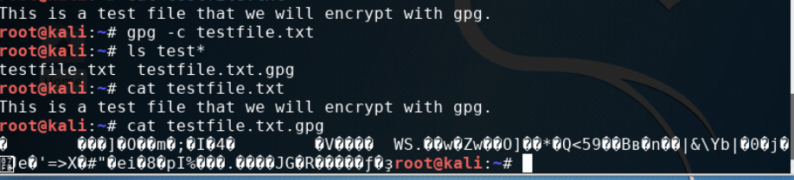
File Encryption
This screenshot includes the following:
Content of the plaintext file
Content of the encrypted file

Slide 5
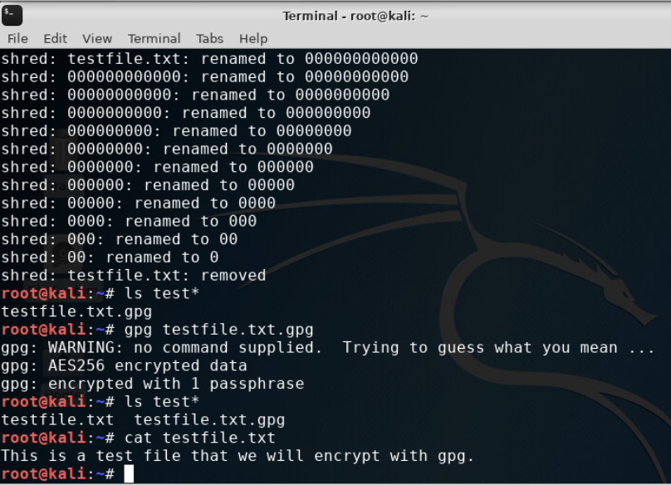
File Decryption
This screenshot includes the following:
The encrypted file being listed by itself
The decrypting process
Both the encrypted file and the original plaintext file being listed

Slide 6

Stateful Firewall
In this module, we hardened a Linux server by setting up a stateful firewall with iptables.
We first used the nmap 192.168.105.55 | more command to scan open ports on the Linux Server VM. We tried a simple firewall rule that drops all incoming connections to the Linux Server VM by using the command, sudo iptables --policy INPUT DROP. We then flushed the INPUT, OUTPUT, and FORWARD chains. We dropped all invalid packets from the server and then forwarded all incoming and outgoing traffic on the loopback interface. We finally added more rules to the firewall. The following slides show the effects of this process.

Slide 7
Question
What effect does the sudo iptables --policy INPUT DROP command have on the access to computing resources?
Answer here:
The sudo iptables --policy INPUT DROP command is a firewall rule that drops all incoming connections to the Linux Server VM.
References:
InfoSec Learning DeVry SEC 285 - Module 3: Stateful Firewall

Slide 8
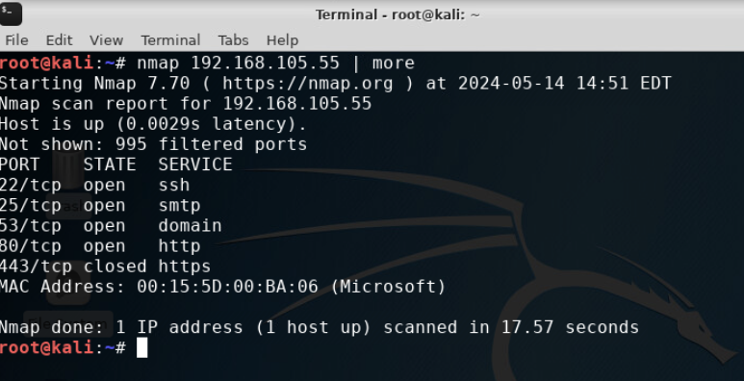
Nmap scan
This screenshot shows the Nmap scan result of the Linux Server VM.

Slide 9

Bring Your Own Device (BYOD)
Security Policy
Security policies are high-level statements approved by senior management to guide the behavior of people who come into contact with organizational computing resources. A security policy is a set of documents that clarify an organization’s expectations regarding the proper usage of their computing resources. It specifies which behaviors are considered acceptable and which are not.
There are three categories of security policies: program policy, issue-specific policy, and system-specific policy.

Slide 10
1. Overview:
Tablets, smartphones, and laptops can be very beneficial to the workplace. The ability to utilize a personal device can lead to more productivity and better communication between coworkers. However, using personal devices in the workplace can lead to security risks. All SANS employees must follow this policy to ensure network security is maintained.
2. Purpose:
The purpose of this policy is to ensure that no unnecessary vulnerabilities are introduced to the SANS computing resources. In order to prevent data from being stolen or compromised, it is important to identify devices that have been attacked promptly. With this being said, if you identify an attack on your device or think your device may have been attacked, let the IT department know immediately. This will allow the IT department to address the attack early, to prevent other devices and company computers from being exposed to the attack.

Slide 11
3. Scope:
Employees who wish to connect personal devices to the company network may do so with approval from the IT department. These devices include laptops, smartphones, tablets, and smartwatches. Activity conducted on your personal devices while connected to the company network should always remain professional.
4. Policy:
All personal devices are subject to a security assessment before acceptance to the SANS network. These security assessments will be conducted solely by the IT department. In order to remain compliant with this policy, all devices must be running the latest OS with available patches, have up-to-date antivirus software installed, and a firewall, which will all be checked by the IT department regularly. If devices are non-compliant, they will be removed from the network until all necessary updates are completed and checked by the IT department.

Slide 12
5. Policy Compliance:
The InfoSec team will verify compliance to this policy through various methods, including but not limited to, periodic walk-through, video monitoring, intrusion detection tools, business tool reports, internal and external audits, and feedback to the policy owner.
If any employee is found not following the BYOD policy, the device(s) in question will be removed from the network and permissions to access databases will be revoked until a thorough inspection is completed by the InfoSec team. Depending on the outcome of the inspection, employees may be subject to disciplinary actions including suspension and possible termination of employment.
6. Related Standards, Policies, and Processes:
HIPAA, PCI-DSS, and SANS employee standards are linked to this policy and should be followed at all times. The saving of or sharing personal health data or financial data in an effort to utilize it for personal gain is strictly prohibited. An employee found in insubordination with these linked policies will be subject to immediate termination.

Slide 13
7. Definitions and Terms:
BYOD – Bring Your Own Device
CIA – Confidentiality, Integrity, and Availability
OS – Operating System
HIPAA – Health Insurance Portability and Accountability Act of 1996
PCI-DSS – Payment Card Industry Data Security Standard
8. Revision History:

Slide 14

Multifactor Authentication (MFA)
Many enterprise end users use a single password to gain access to all computing resources. This is known as single sign-on (SSO). This simplifies the authentication process of an end user but also makes it easier for an attacker to compromise the process. To mitigate the risk, multifactor authentication (MFA) uses a regular password and a time-based one-time password (OTP). In this module, the one-time password is generated by using the Google Authenticator app available to Android and iOS devices.

Slide 15
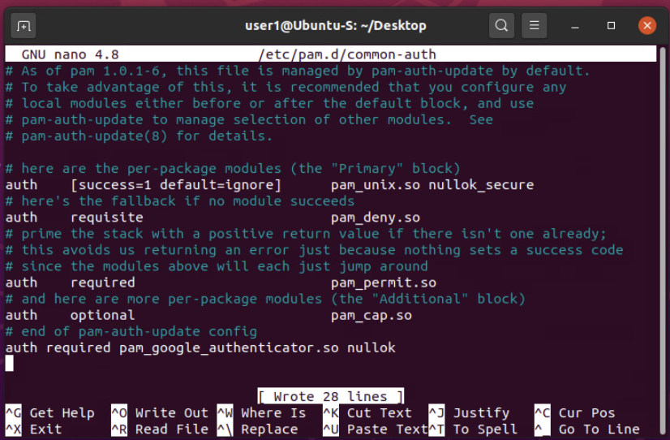
Common-auth Configuration File
This screenshot shows the entry that indicates the use of the Google Authenticator module.

Slide 16
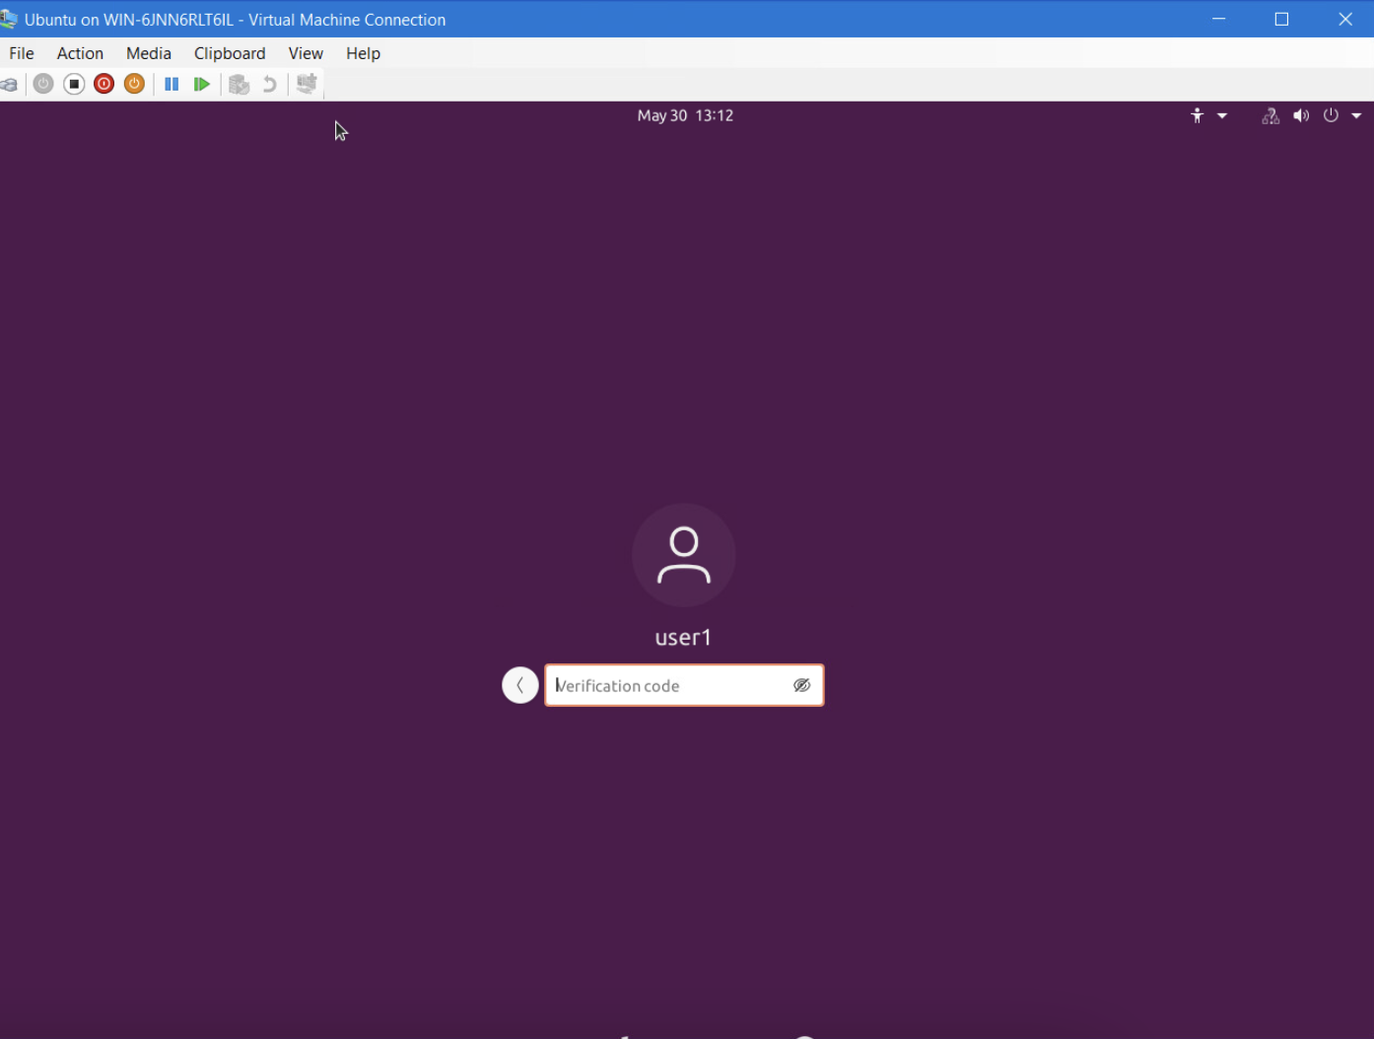
MFA Logon Screen
This screenshot shows the logon screen where a verification code is required.

Slide 17
Vulnerability Assessment
To conduct a vulnerability assessment of a server in a testing or production environment, security practitioners use tools such as NMAP (the network mapper), Netcat, and Wireshark.
To prepare for the vulnerability scanning, we first checked the IP addresses of the VMs.
The NMAP tool can be used to identify IP addresses that are in use on a network segment, assuming that the hosts on the network segment are up and running.
The Netcat tool can be used to gain information about FTP, SSH, and SMTP applications that are discovered in an NMAP scan (called banner grabbing). Knowing the version of an application running on the server can be a great help in the exploitation phase.
Wireshark is a packet sniffing tool. It can be used by security practitioners to analyze network traffic and gain insight into client and server applications.
Nessus Essentials is a free vulnerability scanner that provides an entry point for vulnerability assessment.

Slide 18
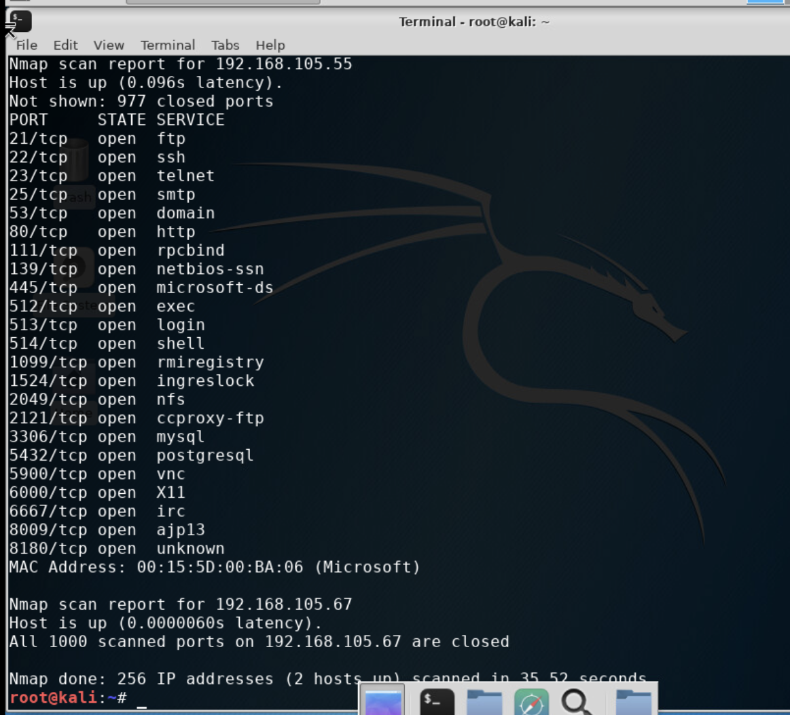
Nmap
This screenshot includes the scan result showing both the Kali and Linux Server VMs.

Slide 19
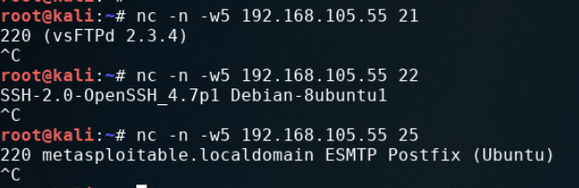
NetCat
This screenshot includes the scan result showing both the Kali and Linux Server VMs.

Slide 20
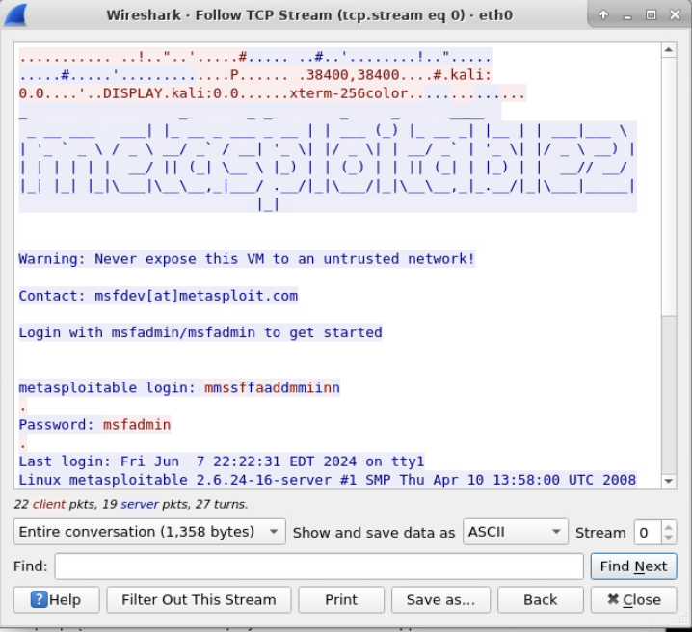
Wireshark
This screenshot includes the Wireshark—Follow TCP Steam window showing the Telnet username and password.

Slide 21
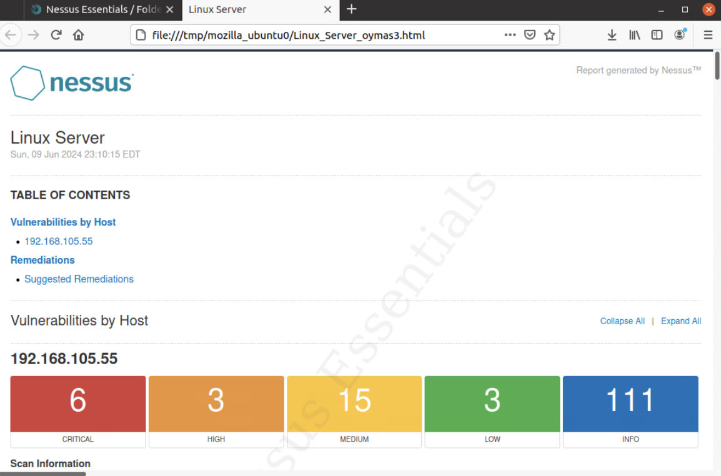
Nessus
This screenshot includes the high-level view of the Nessus vulnerability scan report (showing categories of vulnerability in different colors).

Slide 22

Challenges
While I have experience working within a computer’s terminal window, I had very limited knowledge of information security practices before taking this course. This course covered a lot of important information security topics in a short amount of time which was challenging for me to grasp.

Slide 23

Career Skills
Almost all corporations have a team of professionals who mitigate information security risks and know how to respond to threats. We learned many skills in this course that would be useful in InfoSec career roles. Some of these skills include:
Analyzing and eliminating threats or vulnerabilities
Identifying attacks and vulnerabilities to mitigate before they infiltrate information systems
Cryptography
Firewall knowledge
Multifactor Authentication (MFA)

Slide 24
Conclusion
This course covered many useful skills to keep information security intact. We covered topics that prepare us for the CompTIA Security+ Certification. After this course, we can identify and work with tools that help mitigate and identify security risks and threats.
While my career goals do not align perfectly with information security, these skills are invaluable to anyone working in the technology field.

Slide 25
References
DeVry SEC 285 - Module 2: Asymmetric Key Encryption
DeVry SEC 285 - Module 3: Stateful Firewall
SEC285 Course Project Guide Module 4
DeVry SEC 285 - Module 5: Multifactor Authentication (MFA)
DeVry SEC 285 - Module 6: Vulnerability Assessment

